Slide 1
My parents
&
my specialty

Slide 2
Thesis
Parents and children can actually be harmonious.

Slide 3
论证思路
Perspective 视角
construction
1
2
3
Perspective of
children
Perspective of
parents
conclusion

Slide 4
PART 1
From the perspective of children

Slide 5
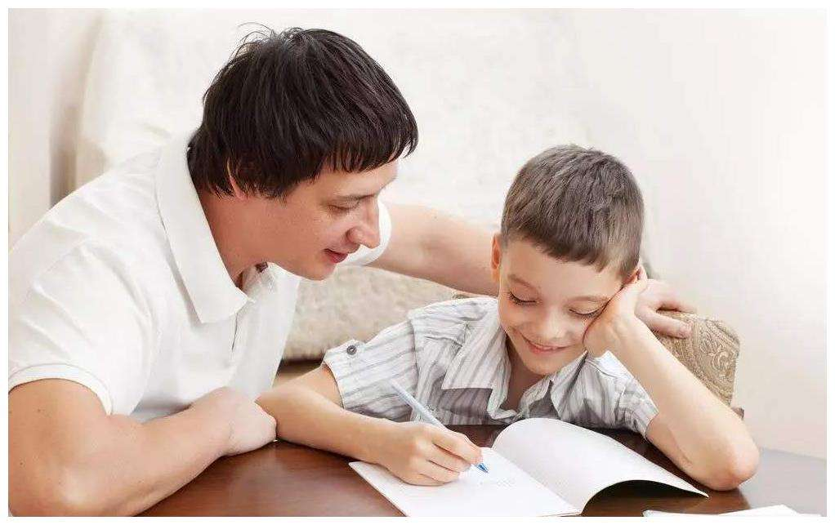
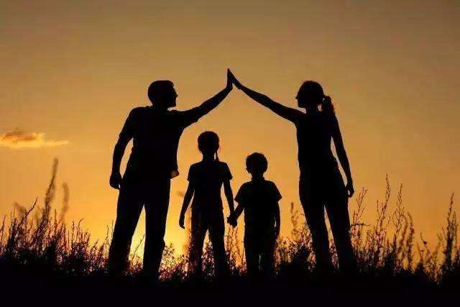
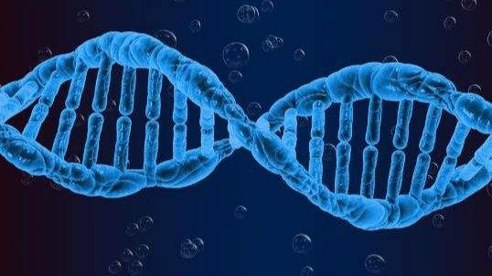
From the perspective of children
The gene
The education
The environment

Slide 6
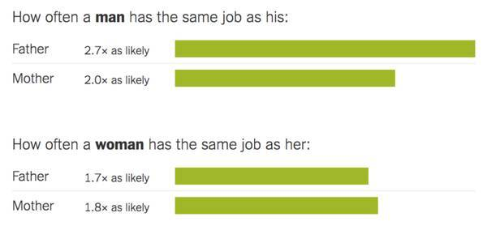
The gene
Like father, like son.
有其父必有其子

Slide 7

The education
On the one hand, the education of parents will reshape character.
On the other hand, the education of self selection ability.

Slide 8
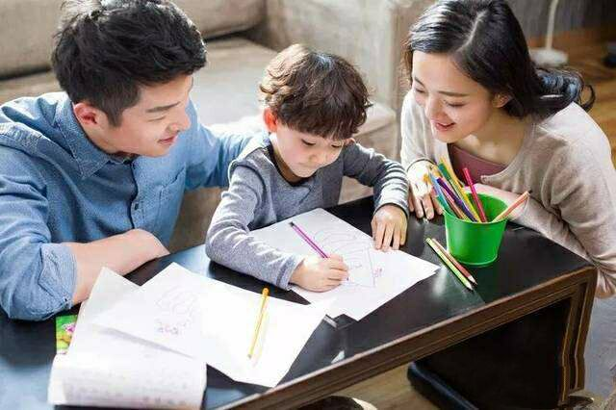
The environment
Parents’ identification(认同感) with their profession and the ideas transmitted by parents.

Slide 9
Part2
From the perspective of parents

Slide 10
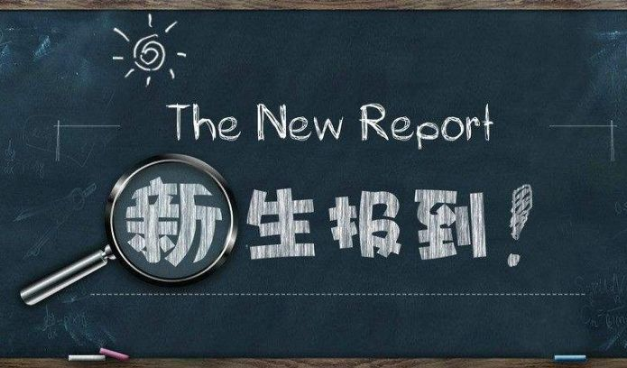
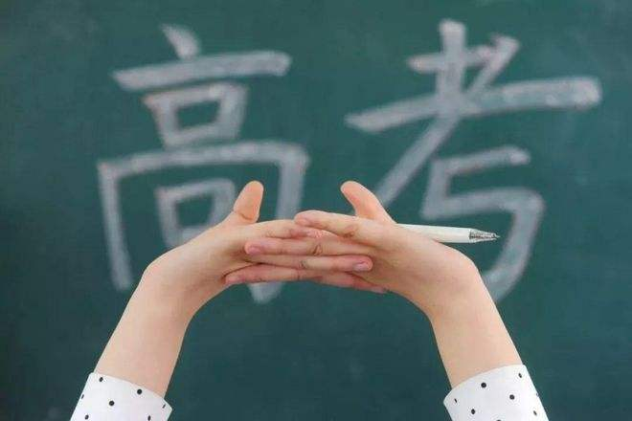
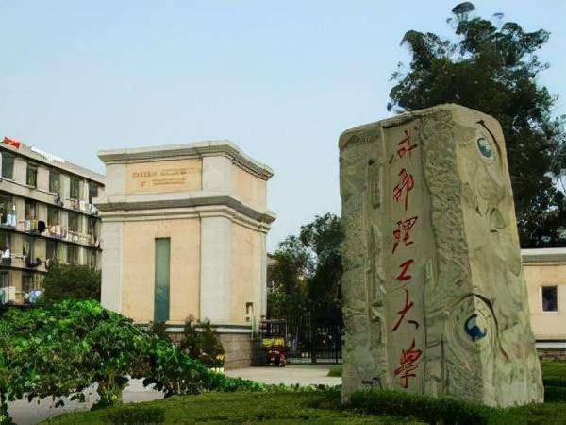
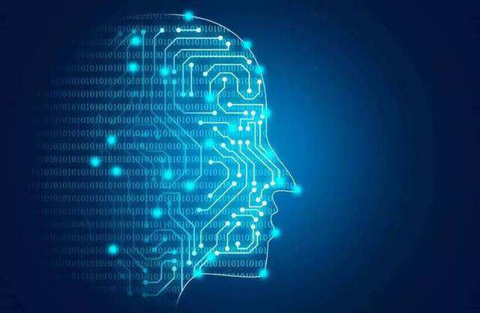
From the perspective of parents
High school
CEE
1
2
Specialty
University
4
3

Slide 11
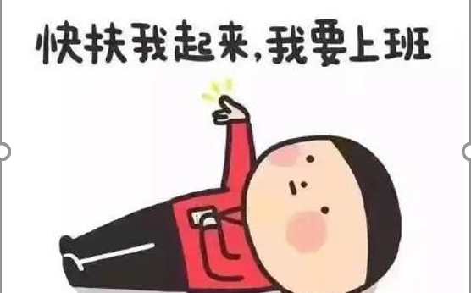
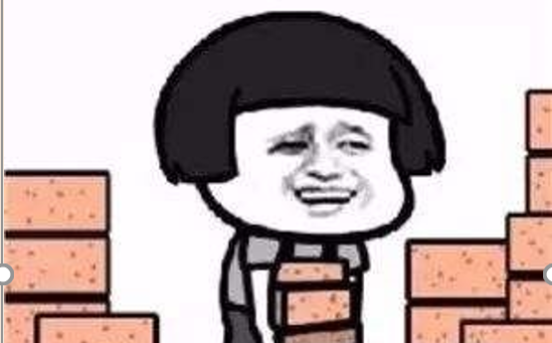
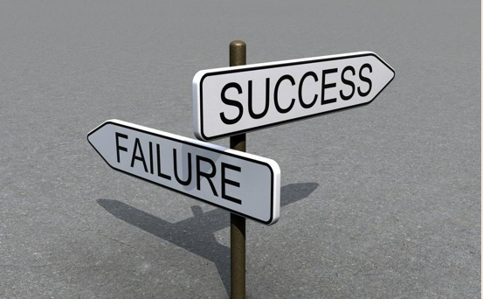
From the perspective of parents
Experience setbacks
Curvy road
Tired at work

Slide 12
From the perspective of parents
Experience
How to find a job?
How to live?

Slide 13
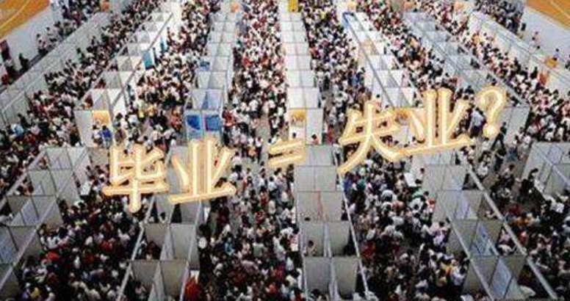
From the perspective of parents
Many graduates have not found a job
PPT模板 http://www.1ppt.com/moban/

Slide 14
LOVE

Slide 15
PART 3
Conclusion

Slide 16
conclusion
?
Because we haven't been parents, and we're kids, they're parents. We play different roles, they care about us, care about kids in every aspects. But we're kids now and can't think so far.
Why we can’t understand parents？
因为我们没有做过父母，因为我们是孩子，他们是父母，扮演的角色不同。他们会为孩子考虑，处处为你着想，你现在是孩子，你想不到那么远。

Slide 17
conclusion
Parents and children can actually be harmonious, if we can consider each other. Maybe it will be years later.
总是向你索取
却不曾说谢谢你
直到长大以后
才懂得你不容易
词 / 王太利
电影《父亲》

Slide 18
“我，坐在斜阳浅照的石阶上，望着这个眼睛清亮的小孩专心的做一件事；是的，我愿意等上一辈子的时间，让他从从容容的把这个蝴蝶结扎好，用他五岁的手指，孩子，慢慢来，慢慢来。”
所谓父女母子一场，只不过意味着，你和他的缘分就是今生今世不断地在目送他的背影渐行渐远。你站在小路的这一端，看着他逐渐消失在小路转弯的地方，而且，他用背影默默地告诉你，不用追。
龙应台，前中华人民共和国台湾省文化部部长

Slide 19
THANKS FOR YOUR LISTENING

